Slide 1

IISR Training Day1
NLP 101
2023/08/24
Mind

Slide 2
Outline
NLP Introduction
Definition
Tasks
Sentiment Analysis Task
Useful Tools
tokenization: nltk
word embedding: gensim.models.word2vec
Implementation in Colab 1
ChatGPT

Slide 3
NLP Introduction

Slide 4
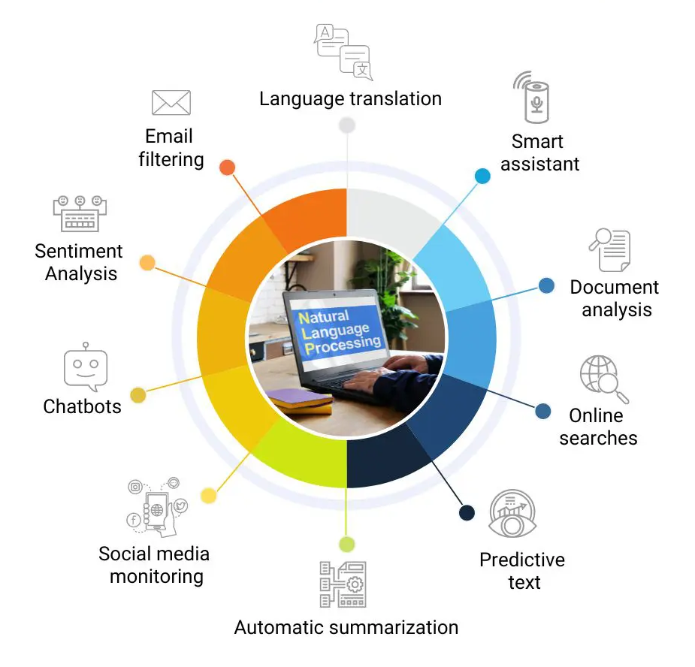
Definition
Natural Language : The language that humans use for everyday communication
Natural Language Processing (NLP) : The development of algorithms and models that enable computers to understand, interpret, generate, and respond to natural language
Notes:
Text Analysis: Sentiment Analysis, Named Entity Recognition
Machine Translation: Google translate
Text Generation: Autocomplete, Chatbots (ChatGPT)
Speech Recognition: Siri, Alexa
Question Answering: Assistent Chatbots (Airline chatbot)
Text Summarization: ChatPDF

Slide 5
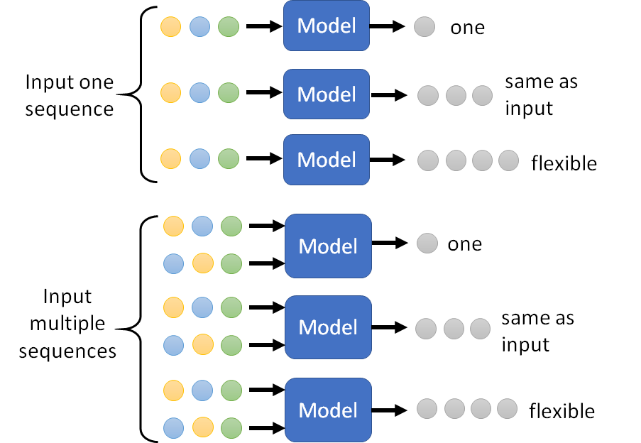
[Hung-yi Lee, NTU]
POS Tagging
Question Answering(QA)
Machine Translation(MT)
Natural Language Inference(NLI)
Sentiment Analysis(SA)

Slide 6
[Hung-yi Lee, NTU]
Sentiment Analysis(SA)
POS Tagging
Machine Translation(MT)
Natural Language Inference(NLI)
Question Answering(QA)

Slide 7



Sentiment Analysis
[Hung-yi Lee, NTU]
Input: One sequence
Output: One
《user1》 An Unforgettable Delight!
《user2》It's a shame because I love Little Women and Lady Bird. Barbie did not serve.
《user3》"Barbie Movie" - A Whimsical and Empowering Adventure for All Ages
《user4》The first 30 min had me wondering what I'd got myself into & not sure I'd want to hang for the remaining 90 min.

Slide 8
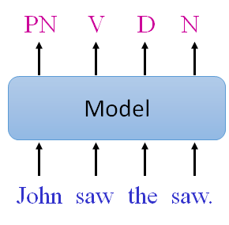
Part-of-Speech (POS) Tagging
[Hung-yi Lee, NTU]
Input: One sequence
Output: Same as input

Slide 9
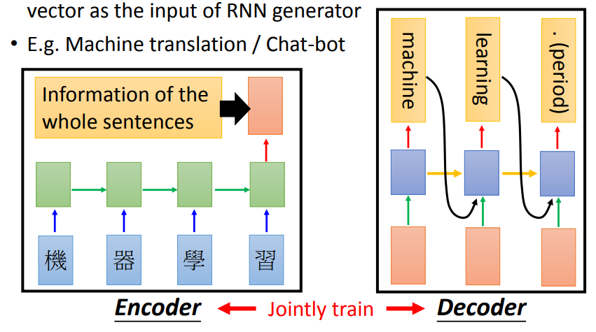
Machine Translation
[Hung-yi Lee, NTU]
Input: One sequence
Output: Flexible

Slide 10
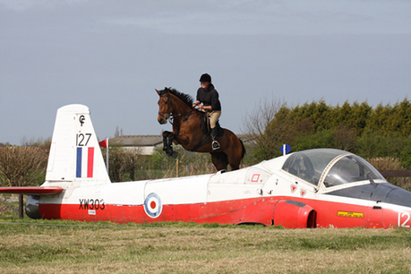
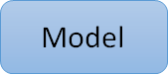
Natural Language Inference
[Hung-yi Lee, NTU]
Input: multiple sequences
Output: One
contradiction
entailment
neutral
premise: A person on a horse jumps over a broken down airplane
hypothesis: A person is at a diner.
hypothesis: A person is outdoors, on a horse.
hypothesis: person is training his horse for a competition.

Slide 11

Natural Language Inference
[Hung-yi Lee, NTU]
Input: multiple sequences
Output: One
????
????
????
????
?????
????
????
????
neutral?
neutral?
????
entailment?
????
????
????
????
contradiction?
contradiction?
????
????
entailment?
????

Slide 12
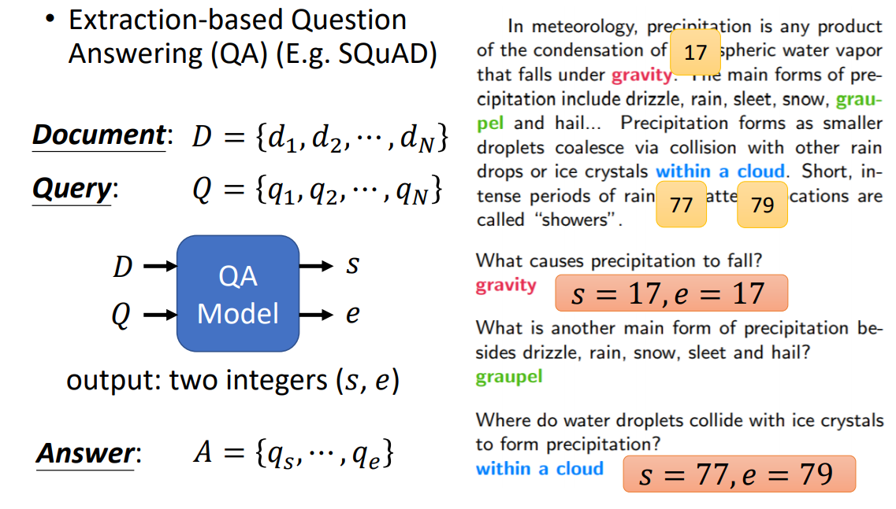
Question Answering
[Hung-yi Lee, NTU]
Input: Multiple sequences
Output: Flexible
29
s = 29, e = 29

Slide 13

Sentiment Analysis Task
Notes:
監督式

Slide 14

An Example From Dataset
['Bad plot, bad dialogue, bad acting, idiotic directing, the annoying porn groove soundtrack that ran continually over the overacted script, and a crappy copy of the VHS cannot be redeemed by consuming liquor. Trust me, because I stuck this turkey out to the end. It was so pathetically bad all over that I had to figure it was a fourth-rate spoof of Springtime for Hitler.<br /><br />The girl who played Janis Joplin was the only faint spark of interest, and that was only because she could sing better than the original.<br /><br />If you want to watch something similar but a thousand times better, then watch Beyond The Valley of The Dolls.’,
'negative'],
Review
Label
‹#›
Notes:
資料集 50,000

Slide 15
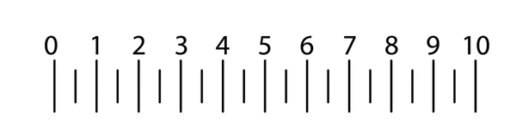

positive(1)
0 or 1
Model Training (模型訓練)
Model Evaluation (模型評估)
Model Inference (模型預測)
array([-0.60393849, 0.58233042, -0.37822927, 0.17251187], dtype=float32)
Dataset & Batch
array([ [-1.2365655 , -0.05423837, -0.3815712 , -0.9078817 , 1.4006518], dtype=float32)
Pre-processing
Word Embedding (詞向量)
['this', 'is', 'a', 'great', 'movie.']
Tokenize (斷詞)
this is a great movie.
Training Set
Development Set
(Public Test Set)
Test Set
(Private Test Set)
‹#›
Notes:
SA的流程
資料集: 有三個, 或是自己切, train訓練模型, valid/dev/public test評估模型, test/private test最後預測
每一筆data是一句電影評論, 標籤是正/負
對每一句斷詞, 每個詞產生向量, 最後dataset是將每一句的詞的詞向量加總取平均, 當作這句評論的sentence embed
最後dataset的輸入是sentence embed, 輸出是標籤, 批次限制每次處理的資料, 降低記憶體需求
監督式的訓練, 給模型答案, 評估overfitting, 預測用沒看過的資料作為最後結果
把資料處理成模型的輸入輸出稱為前處理

Slide 16



Training Set
Development Set
(Public Test Set)
Test Set
(Private Test Set)
Notes:
講解train/dev/test的不同, 以小小兵舉例
第一.二集一起 shuffle後切成train, valid,
test 最後評分, 內容會跟train, valid有點不同, 最新的內容, 檢驗模型應付新問題的能力
為了高分, 模型很會預測第三集, 但好的模型不是為了分數fit in 第三集, 而是模型要辨識得出所有一.二.三集的評論
提問train/valid/test

Slide 17

Useful Tools

Slide 18
Useful Tools - tokenization
NLTK - Natural Language Toolkit
Install NLTK
Download NLTK package
Tokenization
!pip install nltk
import nltk
nltk.download('punkt') #split word from sentence
nltk.download('averaged_perceptron_tagger') # pos tagging
tokens = []
for sen in sentences:
token = nltk.word_tokenize(sen)
tokens.append(token)
print(tokens)
Output:
[['We', 'love', 'IISR'], ['We', 'love', 'ChatGPT'], ['We', 'like', 'study'], ['We', 'hate', 'playing']]
‹#›

Slide 19
Useful Tools - tokenization
NLTK - Natural Language Toolkit
Tokenization
tags = []
for token in tokens:
tag = nltk.pos_tag(token)
tags.append(tag)
print(tags)
Output:
[[('We', 'PRP'), ('love', 'VBP'), ('IISR', 'NNP')],
[('We', 'PRP'), ('love', 'VBP'), ('ChatGPT', 'NNP')],
[('We', 'PRP'), ('like', 'VBP'), ('study', 'VB')],
[('We', 'PRP'), ('hate', 'VBP'), ('playing', 'VBG')]]
‹#›

Slide 20
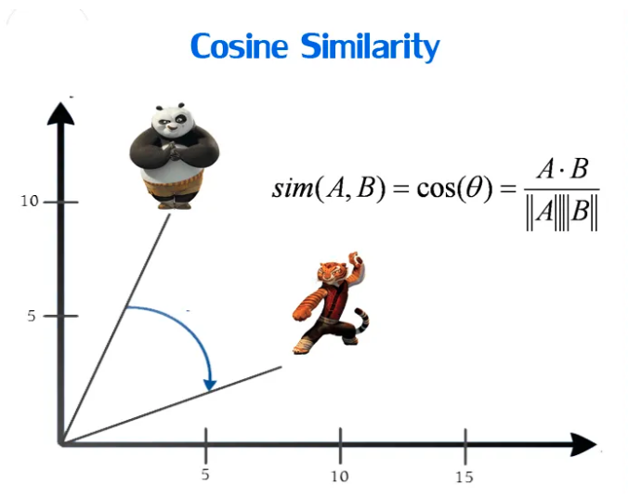
Word embedding - word2vec
One-hot encoding
Word embedding
mango
like
I
apple
= [1,0,0,0]
= [0,1,0,0]
= [0,0,1,0]
= [0,0,0,1]
run
dog
jump
rabbit
cat
tree
flower
A tool (by google) use for creating word embedding.
Word2Vec
‹#›

Slide 21
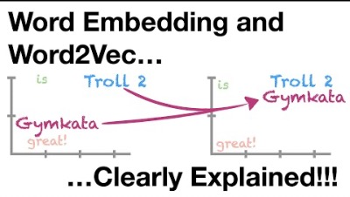
Word embedding - word2vec
‹#›

Slide 22
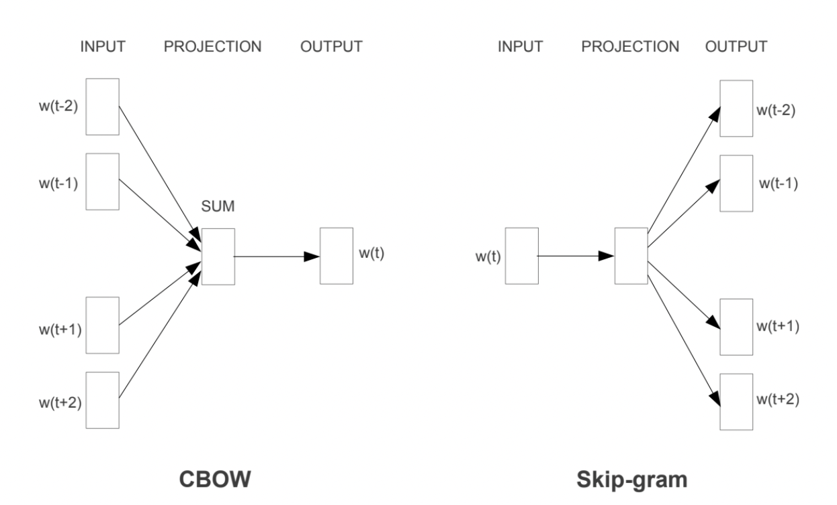
Word embedding - word2vec
Word2vec using Neural Networks – CBOW / Skip-gram
CBOW (Continuous Bag-of-Words Model)
- Given the context, to predict the input word.
Skip-gram (Continuous Skip-gram Model)
- Given the input word, to predict the context.
‹#›

Slide 23
Word embedding - word2vec
[https://radimrehurek.com/gensim/models/word2vec.html]
Word2vec
Parameters
Sentences : text (tokenization)
vector_size : dimensionality of the word vectors
window : maximum distance between the current and predicted word within a sentence
min_count : ignores all words with total frequency lower than this
import gensim
from gensim.models import Word2Vec
w2v_model = Word2Vec(tokens, vector_size=50, window=5, min_count=1)
‹#›

Slide 24
Word embedding - word2vec
Word list
Word vector
words = list(w2v_model.wv.index_to_key)
print(words)
Output:
Output:
['We', 'love', 'playing', 'hate', 'study', 'like', 'ChatGPT', 'IISR']
print('Word: love')
print('Vector: ', w2v_model.wv['love'])
Output:
Word: love
Vector: [-0.01631583 0.0089916 -0.00827415 0.00164907 0.01699724 -0.00892435 0.009035 -0.01357392 -0.00709698 0.01879702 -0.00315531 0.00064274 -0.00828126 -0.01536538 -0.00301602 0.00493959 -0.00177605 0.01106732 -0.00548595 0.00452013 0.01091159 0.01669191 -0.00290748 -0.01841629 0.0087411 0.00114357 0.01488382 -0.00162657 -0.00527683 -0.01750602 -0.00171311 0.00565313 0.01080286 0.01410531 -0.01140624 0.00371764 0.01217773 -0.0095961 -0.00621452 0.01359526 0.00326295 0.00037983 0.00694727 0.00043555 0.01923765 0.01012121 -0.01783478 -0.01408312 0.00180291 0.01278507]
‹#›

Slide 25
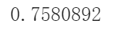
Word embedding - word2vec
Most similar word
Word similarity
w2v_model.wv.most_similar('love', topn=5)
Output:
[('study', 0.12486250698566437),
('ChatGPT', 0.07399576157331467),
('We', 0.04237300902605057),
('like', 0.018277151510119438),
('playing', 0.01107198465615511)]
print('similarity between: love & like', w2v_model.wv.similarity('love', 'like'))
print('similarity between: love & hate', w2v_model.wv.similarity('love', 'hate'))
Output:
similarity between: love & like 0.018277148
similarity between: love & hate -0.17424892
‹#›
Output:

Slide 26

Implementation in Colab 1
20 mins

Slide 27
ChatGPT

Slide 28
